Slide 1
CS 6330 Final Project
Human Gait Analysis
Dan Olson
Rich Lukas
Robert Burkhardt

Slide 2
CS 6330 Final Project
Problem Statement
The Goal of this project was to collect time series data from an IMU, and use it to identify individuals and activities
Gait is the cyclic movement of the body during locomotion
Gait can be broken down into the Stance phase and Swing phase
Stance Phase Stance Phase
Heel Strike Acceleration Phase
Foot Loading Mid-Swing
Midstance shift Deceleration Phase
Heel-off
Toe-off
Movement is highly individualized and unique to each person
Typical tools consist of stop motion photography, pressure sensors, and accelerometers strapped to the body.

Slide 3
CS 6330 Final Project
Methodology
Data Collection
Three test subjects were outfitted with a 6 axis IMU, which recorded angular velocity and acceleration
Data was collected at 500 hz and then down sampled to 100 hz
The sensor was mounted at the hip
The recorded activities included
Walking at a measured pace
Running
Stair climbing/descending
Treadmill
Sitting
Jumping
Standing

Slide 4
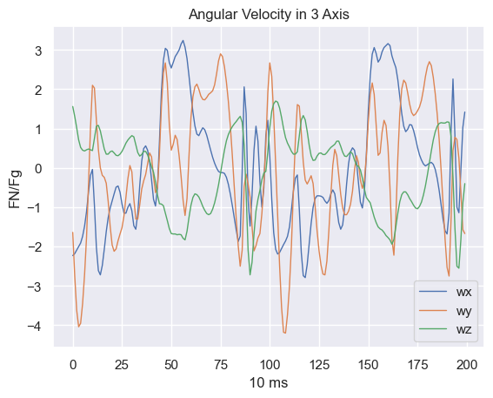
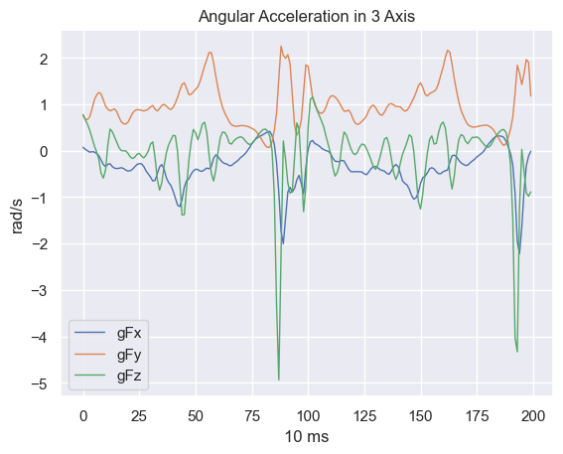
CS 6330 Final Project
Visualization
Visualization of IMU Data Walking at 1 step per second

Slide 5
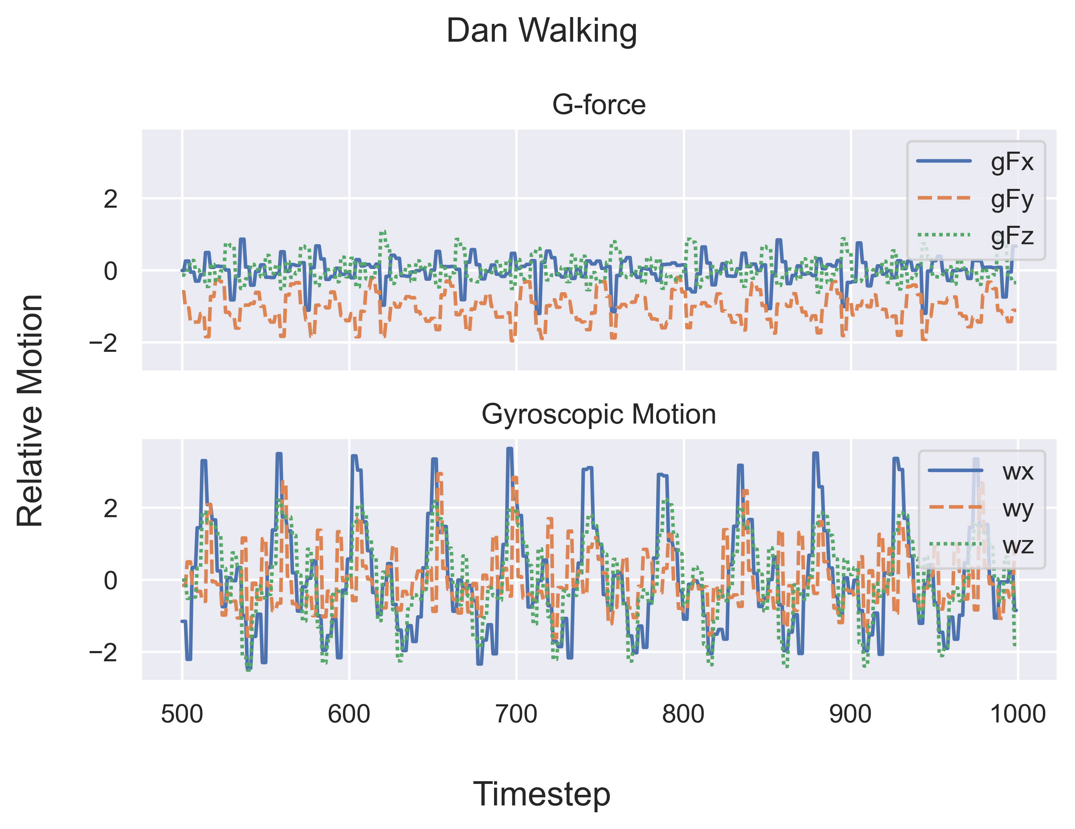
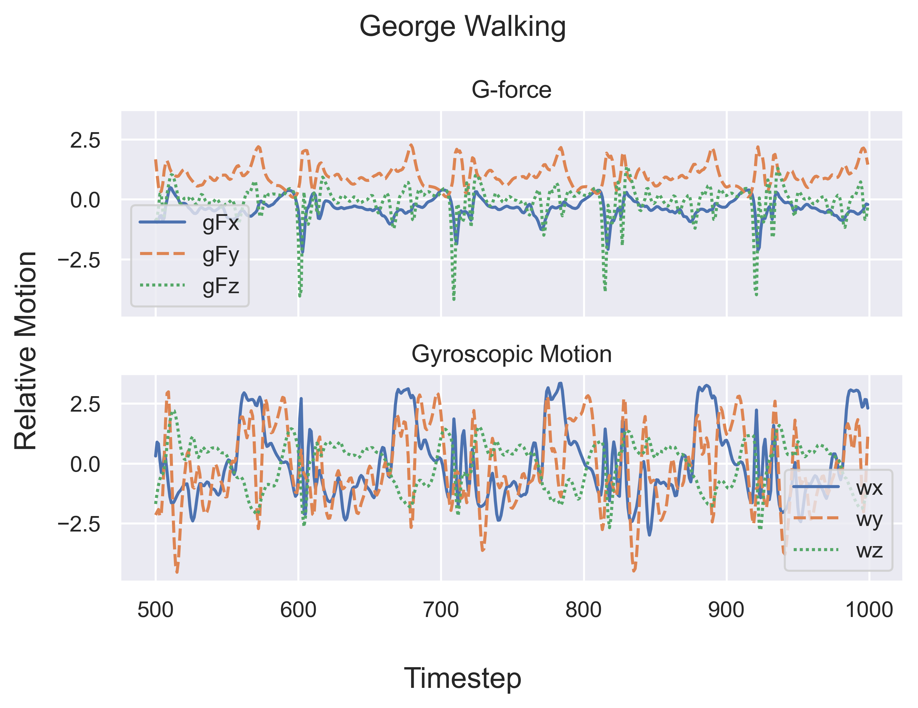
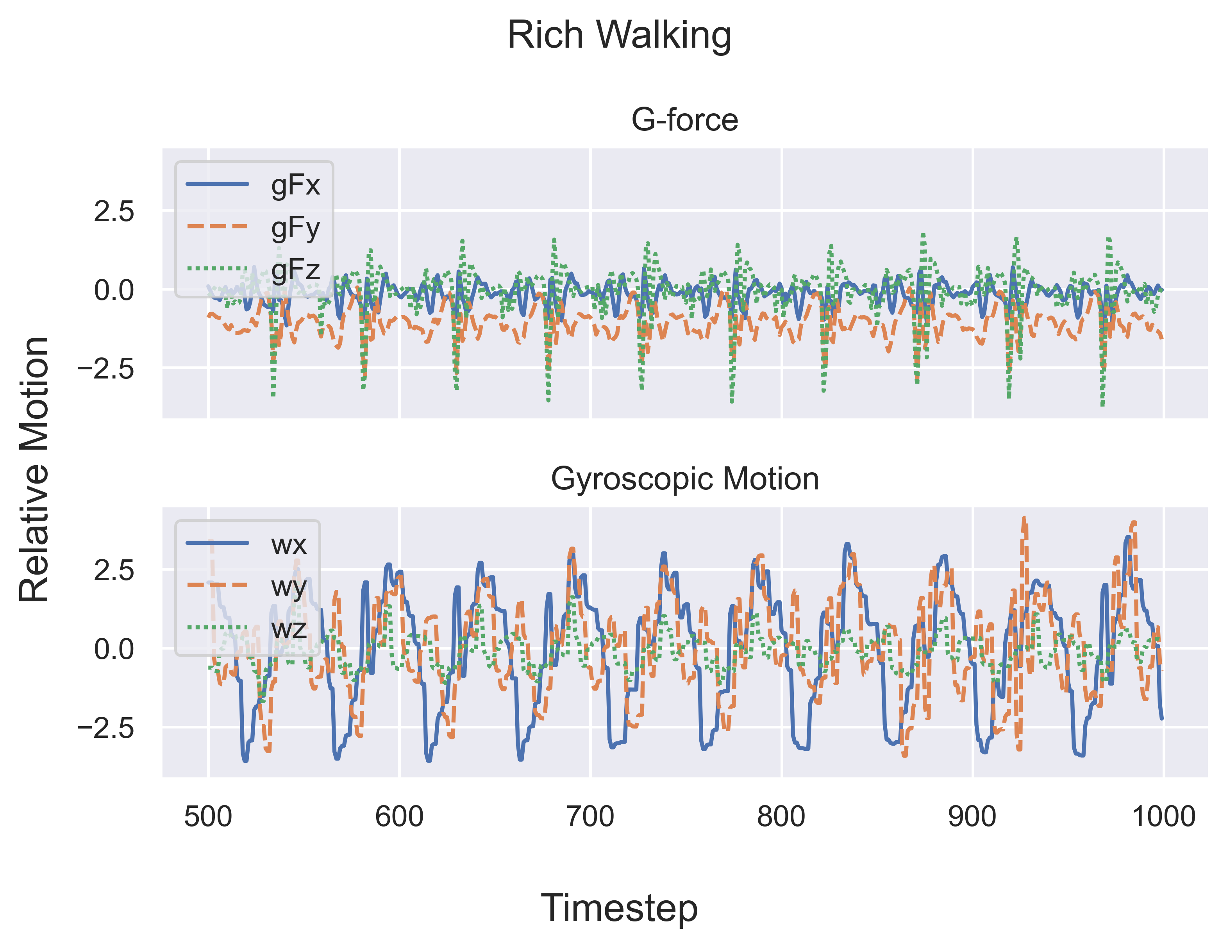
Uniqueness of Gait
Visualization

Slide 6
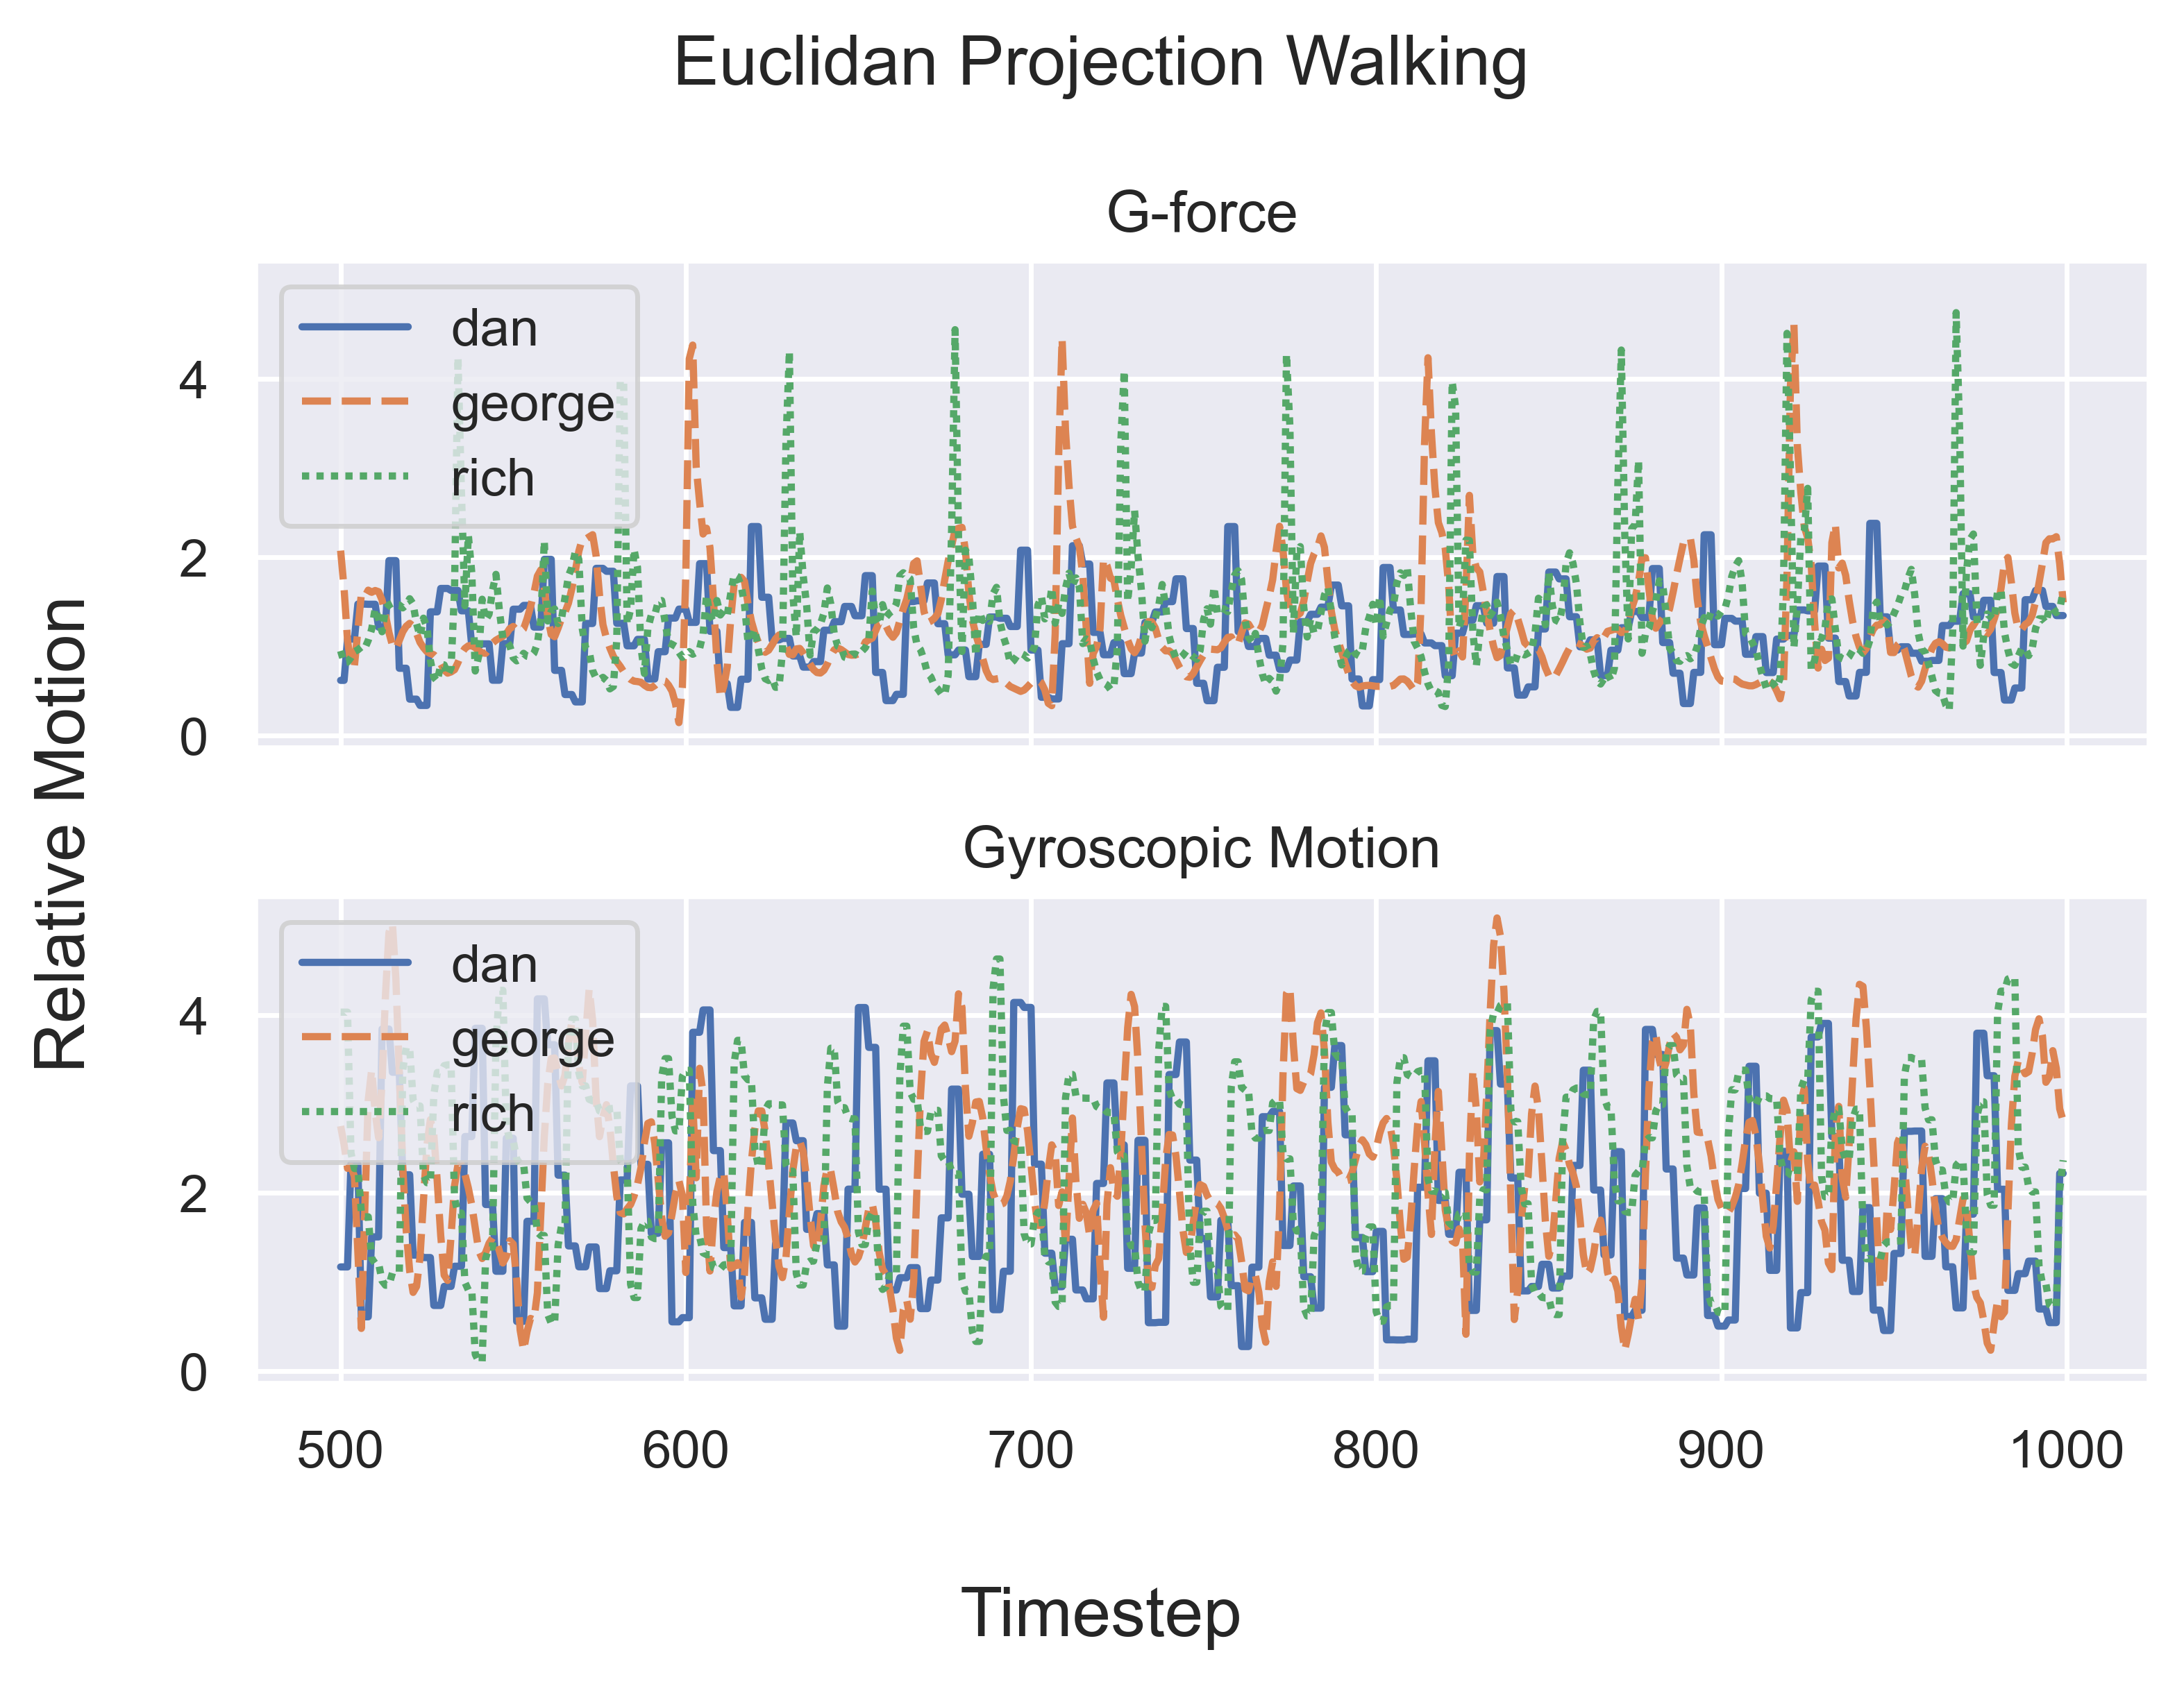
Uniqueness of Gait
Visualization

Slide 7
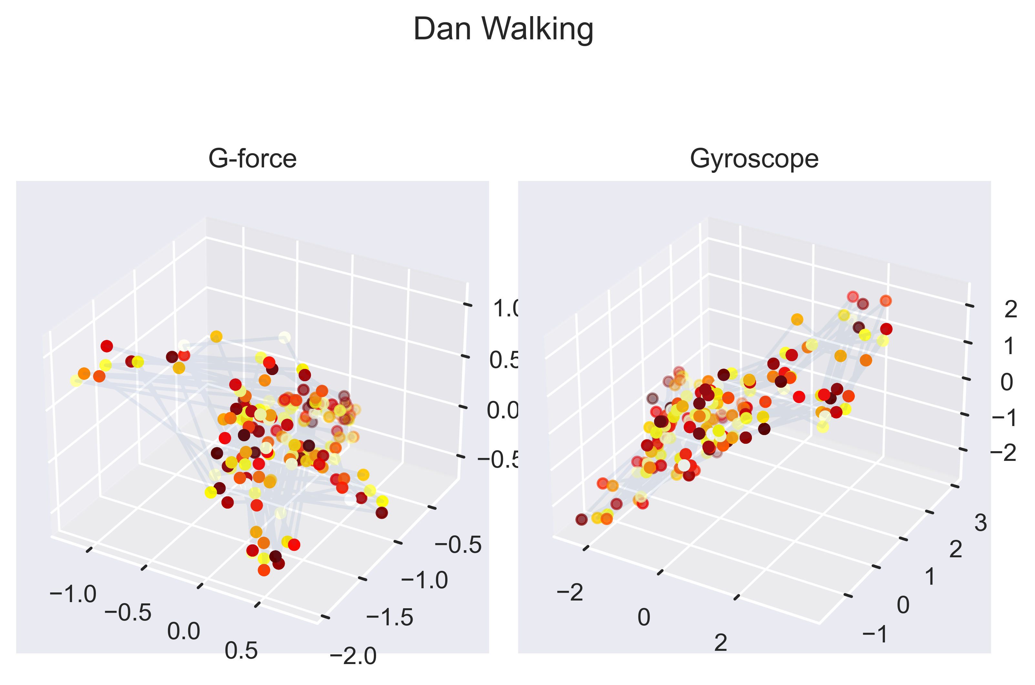
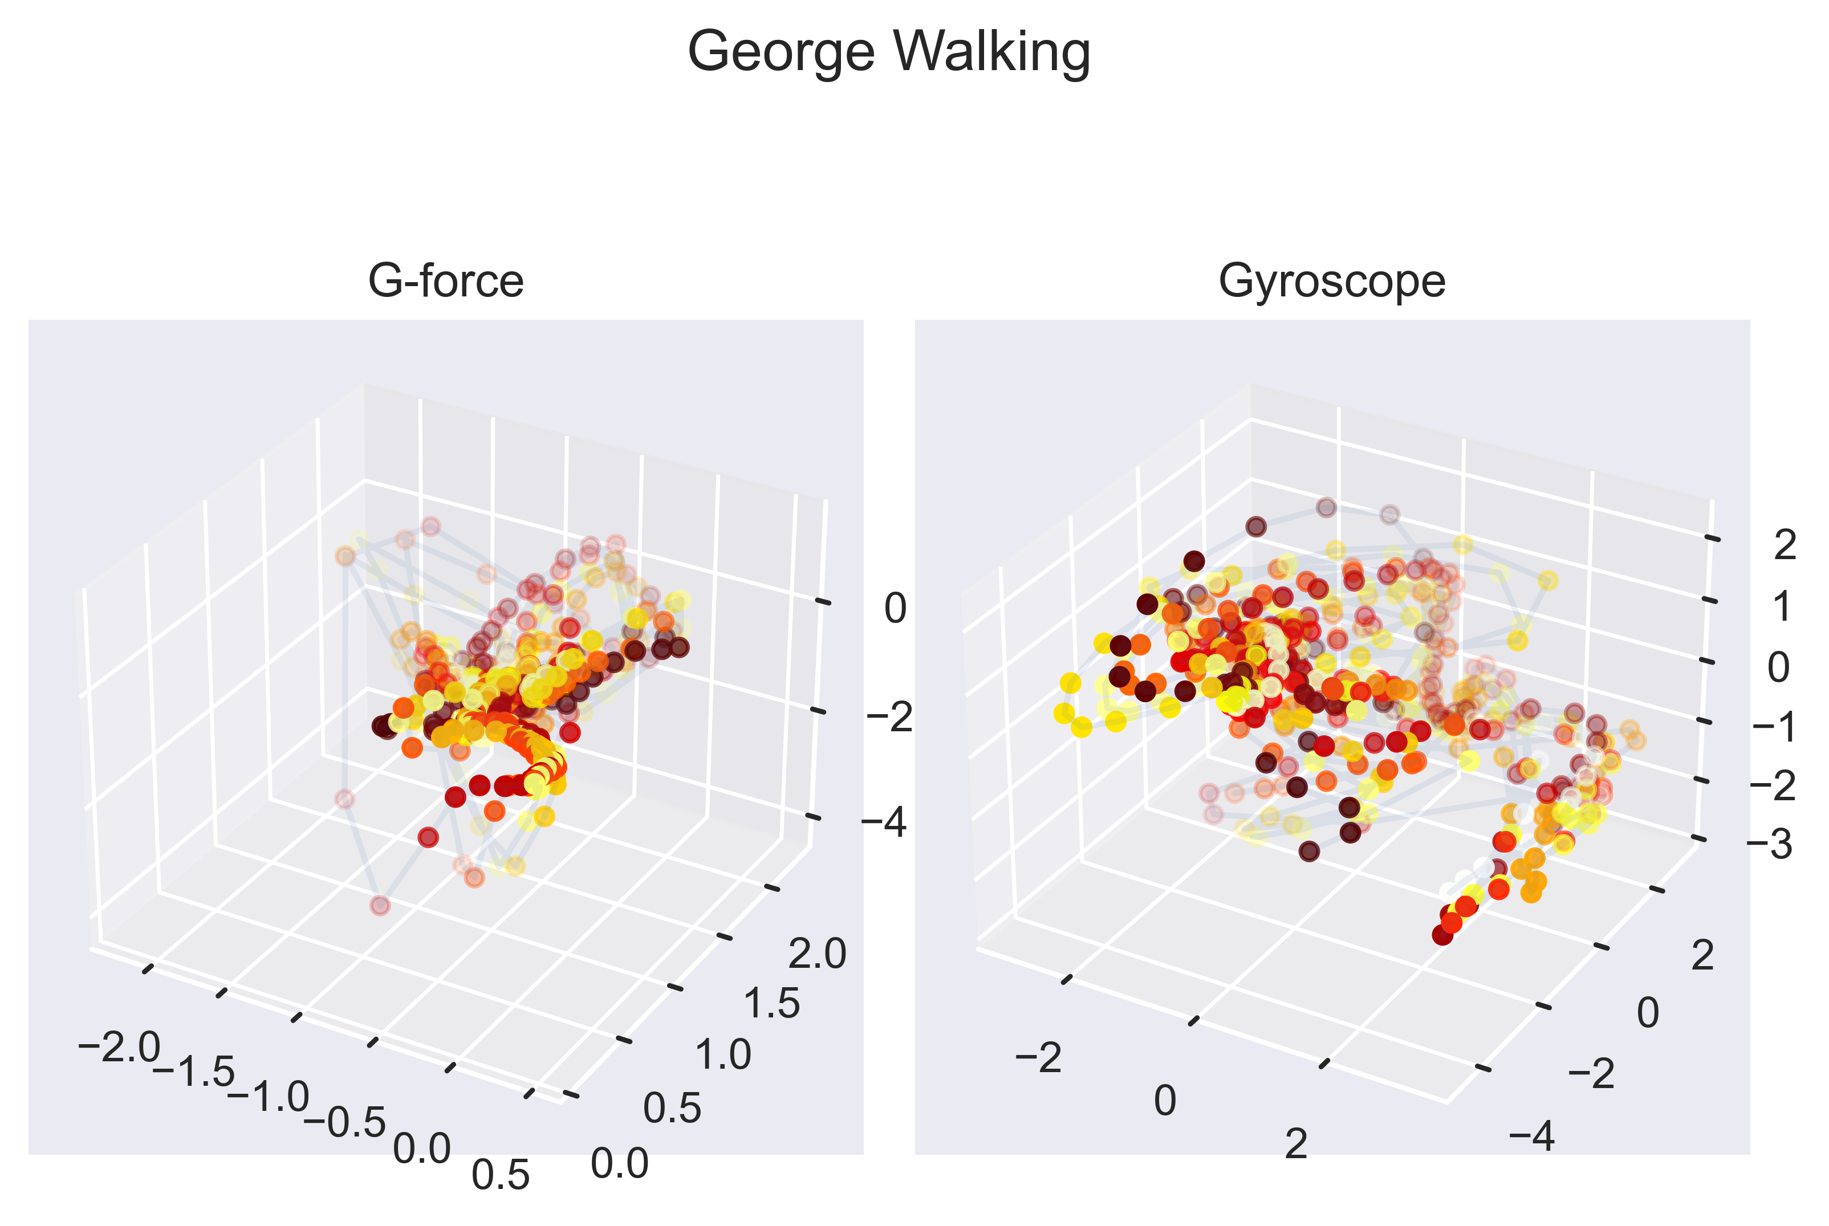
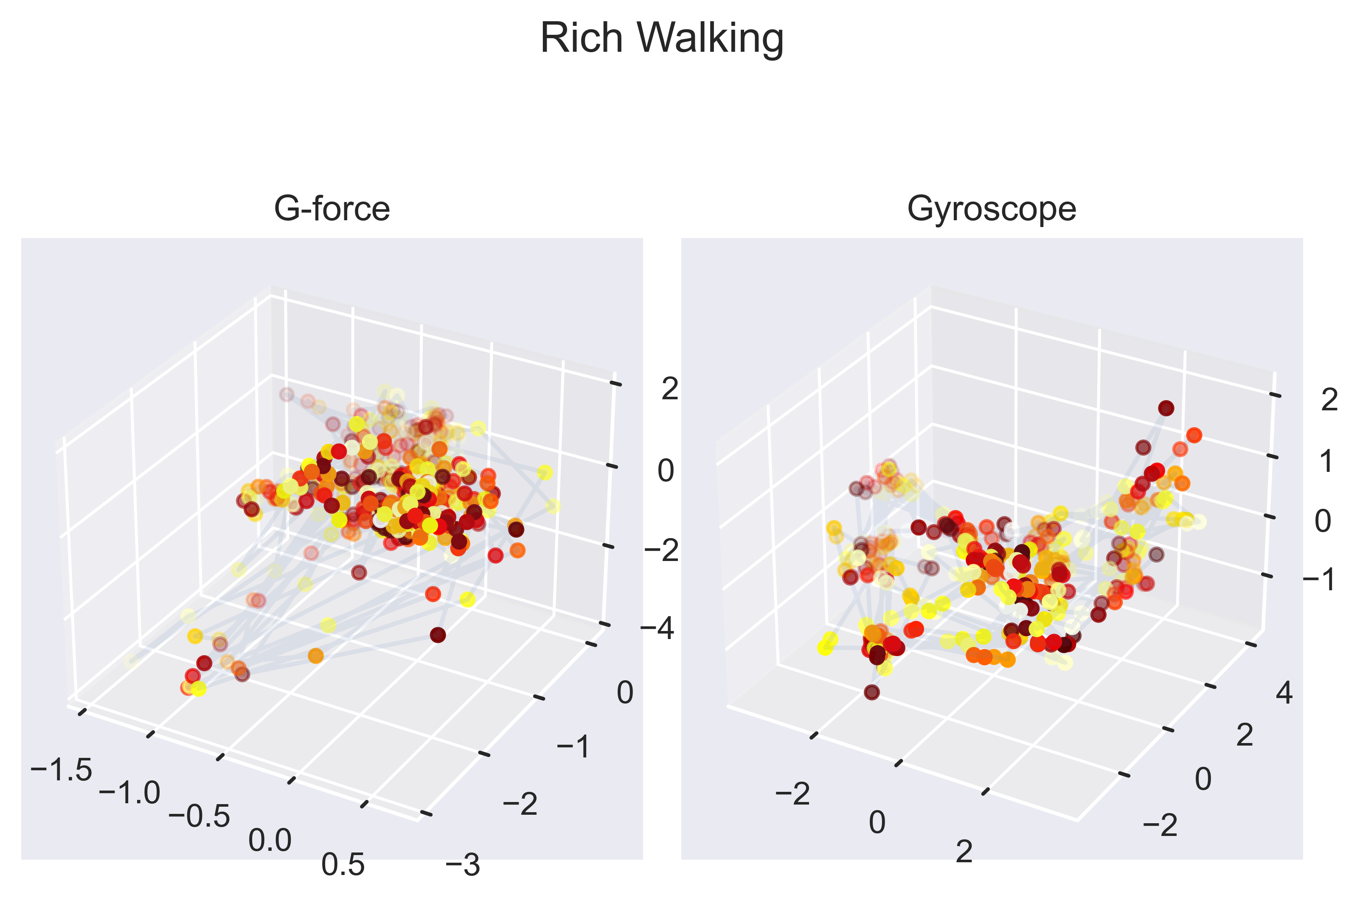
Forces in 3-space
Visualization

Slide 8
Forces in 3-space
Identify Individuals
Initially the instantaneous values of velocity and acceleration were used in building
a classification model. This data proved too noisy, and failed to capture persistent
behavior. After experimentation, an ensemble of gait features were engineered.
Instantaneous Angular velocity and acceleration
Low pass filtered versions of each input
EWMA of each input, with a half life of 100 ms
Multiple Classifier models were developed, including
Logistic Regression
Support Vector Machine
Random Forest
Decision Tree
K Nearest Neighbors
Multi-layer Perceptron Classifier

Slide 9
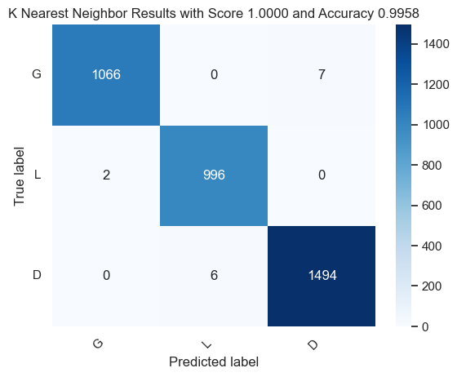
Forces in 3-space
Best Model Results User Identification
Six Different Classifier Models were evaluated, to identify a unique individual. Overall, the best classifier in repeated testing was a model based on K Nearest Neighbors.

Slide 10
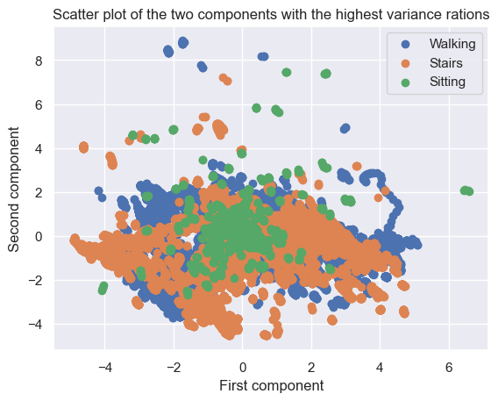
Forces in 3-space
Identify Activity
Time series data on a variety of activities was collected and labeled. The same feature set as before was used to build classifier models.
To help visualize the data a partial correlation analysis was taken to reduce the feature set.
Visually it can be seen
that the data clusters
are heavily overlapped.

Slide 11
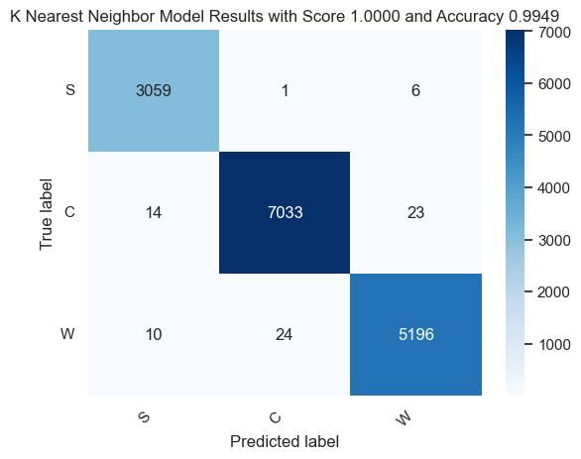
Forces in 3-space
Best Model Results Activity Detection
Six Different Classifier Models were evaluated, to identify a unique individual. Overall, the best classifier in repeated testing was a model based on K Nearest Neighbors. Given the difficulty in separating the clusters, methods such as Logistic and SVM performed poorly. The MLP and Decision Tree performed better. The best result was once again KNN.

Slide 12


Forces in 3-space
Reduction
The Feature Set was gradually reduced to identify a smaller set of features
with similar performance. Angular Velocity is the most predictive
Acceleration Only
Angular Velocity Only

Slide 13
Forces in 3-space
Summary
We met the ask of identifying activity, and identifying individuals based on their gait.
Based on our findings, these explorations could be extended further
Identify Speed/Length of Stride
Abnormal locomotion
Handedness
In theory we can build a power tool that can identify its operator using gait biometrics, rather than a user id. This also suggests that a tool could be customized based on how a user is holding the tool (righty vs lefty etc)

